Slide 1
Complexity of Recursion

Slide 2
Keep in Mind
for(int i = 0 ; i < 5 ; i++)
{
//statements
}
for(int i = 0 ; i < n ; i++)
{
//statements
}
for(int i = 0 ; i < n ; i++)
{
for(int i = 0 ; i < n ; i++)
{
//statements
}
}
O ( 1 )
O ( n )
O ( n^2 )

Slide 3
Examples
Factorial of a Number
Fibonacci Numbers

Slide 4
Factorial of a number n
Factorial of n can be expressed in terms of the factorial of n-1
0 ! = 1
n ! = n x (n-1) x … x 2 x 1 if n > 0
The base case is n = 0
int factorial(int n)
{
if (n == 0) return 1;
else
return n * factorial(n-1);
}

Slide 5
Factorial of a number n
Let’s say n=5
5 x 4 x 3 x 2 x 1!
5
4
3
2
1
5!
5 x 4!
5 x 4 x 3!
5 x 4 x 3 x 2!

Slide 6
Factorial of a number n
int factorial(int n)
{
if (n > 1) return 1;
else
return n * factorial(n-1);
}
Let’s say n=5
5 x 4 x 3 x 2!
5
4
3
2
5!
5 x 4!
5 x 4 x 3!

Slide 7
Fibonacci numbers
0, 1, 1, 2, 3, 5, 8, 13, 21, ...
Recursive solution:
fib(n) = fib(n – 1) + fib(n – 2);

Slide 8
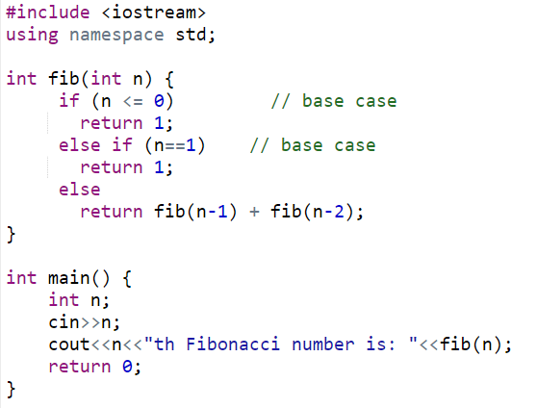
Fibonacci numbers
0

Slide 9
Fibonacci numbers
5th Fib. Number
fib 5
fib 4 + fib 3
fib 3 + fib 2
fib 2 + fib 1
fib 2 + fib 1
fib 1 + fib 0
fib 1 + fib 0
fib 1 + fib 0
= 5

Slide 10


THANK YOU

